Slide 1
네트워크 최신기술
OSPF
20093264 김도헌
20123434 황정담
20 김세훈

Slide 2
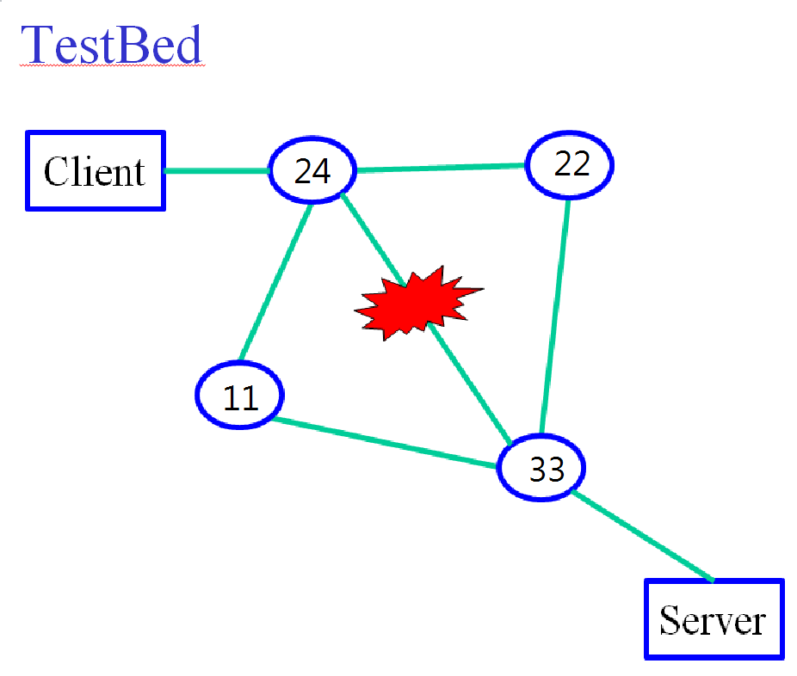
TestBed
cost 10;
hello 3;
retransmit 2;
wait 5;
dead 20;
type broadcast;
authentication simple;
password "pass";

Slide 3
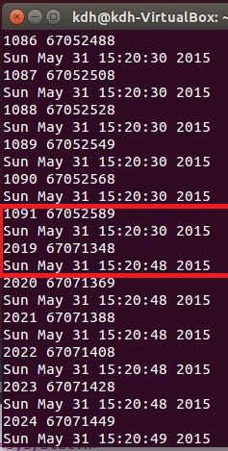
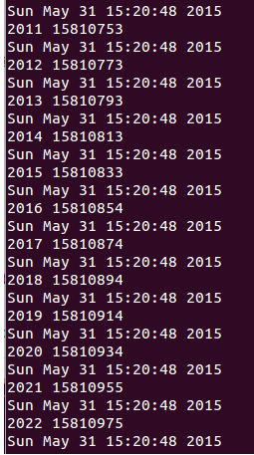
UDP : server & client set
client
server

Slide 4
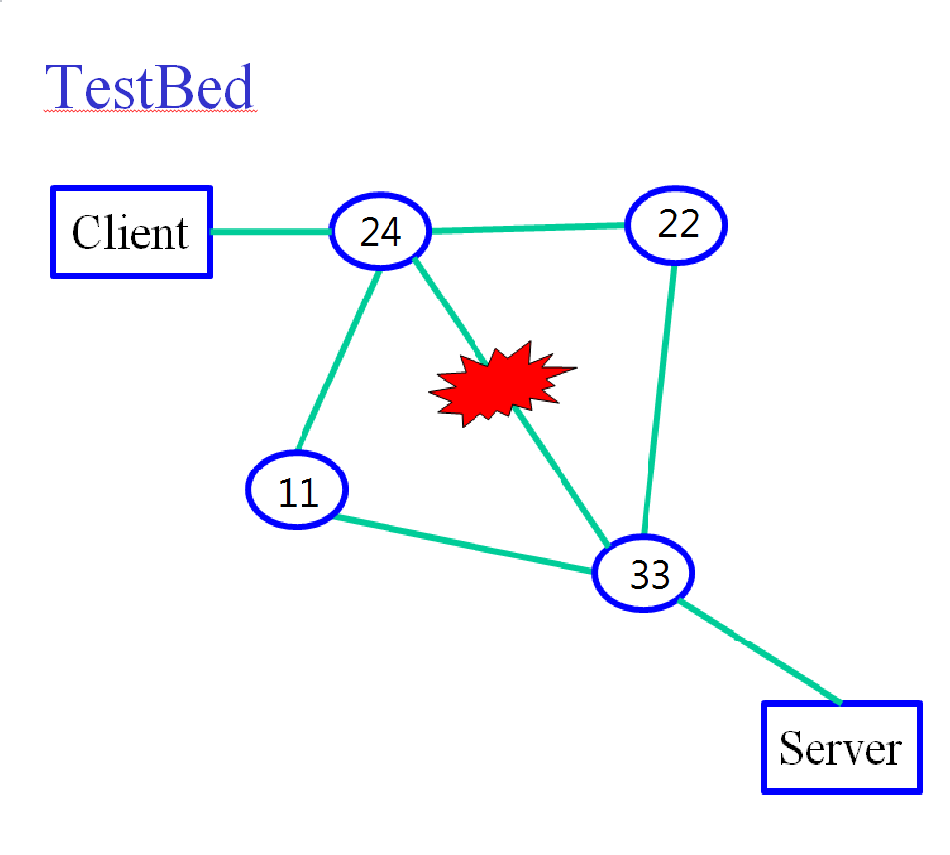
TEST #1 : default set
cost 10;
hello 3;
retransmit 2;
wait 5;
dead 20;
type broadcast;
authentication simple;
password "pass";

Slide 5
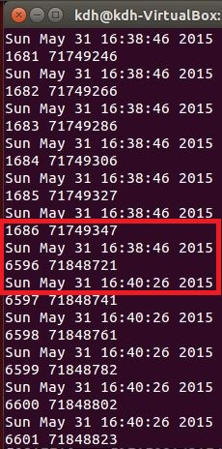
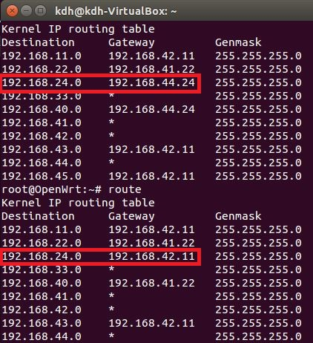
TEST #2: dead 100
cost 10;
hello 3;
retransmit 2;
wait 5;
dead 20->100;
type broadcast;
authentication simple;
password "pass";
Recover time : about 100sec
Routing table :

Slide 6
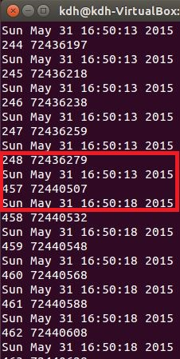
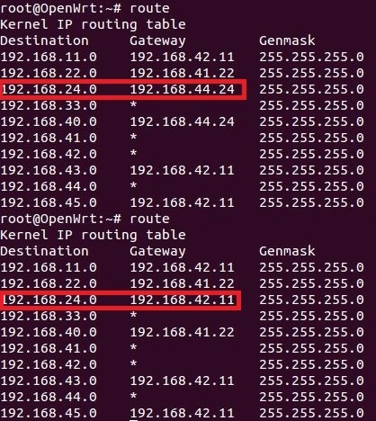
TEST #3: dead 5
cost 10;
hello 3;
retransmit 2;
wait 5;
dead 20->5;
type broadcast;
authentication simple;
password "pass";
Recover time : about 5sec
Routing table :

Slide 7
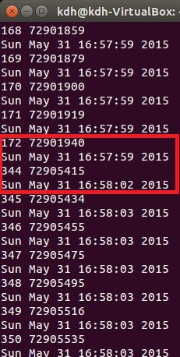
TEST #4: dead 4
cost 10;
hello 3;
retransmit 2;
wait 5;
dead 20->4;
type broadcast;
authentication simple;
password "pass";
Recover time : about 3sec →

